Slide 1
Web Accessibility 101
What you need to know now

Slide 2
What is Web accessibility?
Web accessibility means that websites, tools, and technologies are designed and developed so that people with disabilities can use them.
Web accessibility encompasses all disabilities that affect access to the web content, including:
auditory
cognitive
neurological
physical
speech
visual

Slide 3
Web accessibility benefits everyone
Web accessibility also benefits people without disabilities.
People using mobile phones, smart watches, smart TVs, and other devices with small screens, different input modes, etc.
Older people with changing abilities due to aging
People with “temporary disabilities” such as a broken arm or lost glasses
People with “situational limitations” such as in bright sunlight or in an environment where they cannot listen to audio
People using a slow Internet connection, or who have limited or expensive bandwidth
The following pages highlight portal elements that you, as a content editor, can manage with an eye toward web accessibility.
Page titles
Images
Headings
Color

Slide 4
Pages titles
Page Titles
Check that there is a title that adequately and briefly describes the content of the page.
“Front load” the title with unique or important words first
Poor titles:
Welcome to home page of Acme Web Solutions, Inc.
Acme Web Solutions, Inc. | About Us
Acme Web Solutions, Inc. | Contact Us
Acme Web Solutions, Inc. | History
Better page titles:
Acme Web Solutions home page
About Acme Web Solutions
Contact Acme Web Solutions
History of Acme Web Solutions
Pro Tip
When creating a page in your portal, be sure to fill in the Title field to enable the browser tab to helpfully identify the page to users.

Slide 5
Headings
In addition to a well-chosen page title, your portal content pages should use headings that have a meaningful hierarchy of sections and use the “markup” style supplied in the editing ribbon.
Using this markup enables employees who cannot use a mouse or use a screen reader to navigate more easily through the page by jumping to appropriate sections.
Heading Level 1 <h1>
Heading Level 2 <h2>
Heading Level 3 <h3>
Heading Level 3 <h3>
Heading Level 2 <h2>
Heading Level 3 <h3>
Heading Level 4 <h4>
Heading Level 4 <h4>
Heading Level 2 <h2>
Headings not only help you organize your content, they can also help low or no-vision users jump to relevant content quickly.

Slide 6
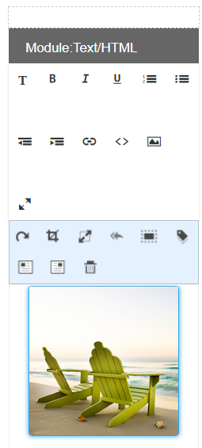
Images and alt text
“Title” is not as necessary for accessibility.
Text alternatives—also known as “alt text’—should be added to images wherever possible.
This allows screen readers to verbally “explain” an image which is not accessible to blind users.
How to add alt text
You can also add the alt text into the HTML using “alt=“some content here” within the image’s “img” content.
Think about how useful the alt text will be if read allowed without the image being viewable.
Decorative images or backgrounds can use “null” or be blank for alt text.
Alt text should be concise and useful.

Slide 7
Images and alt text
Key Concepts
Alt text is applied to images to enable screen readers to provide an audible description of the image—since the image won’t be visible to sight-impaired users.
If the image is purely for decoration, like a background color or design element—in other words, it doesn’t provide instructions or directions—the alt text can be blank or “null.”
Good: “Search”
Less good: “Magnifying glass”
Alt text should be concise and useful.

Slide 8
Text and Links
Avoid these accessibility pitfalls
Centered Text
The quick brown fox jumped over the fence. The quick brown fox jumped over the fence. The quick brown fox jumped over the fence. The quick brown fox jumped over the fence. The quick brown fox jumped over the fence.
For text and links, use color sparingly and don’t rely on it for emphasis.
Ensure that links can be easily identified on the page with a discernable hover state (underline, for example).
Use helpful words for links and buttons. “Explore medical benefits” is much better than “Learn more.”
ALL CAPS
IT MIGHT BE TEMPTING TO USE FOR NAVIGATION BUT IT’S ACTUALLY HARDER TO READ AND CAN BE READ INACCURATEY BY SCREEN READERS.

Slide 9
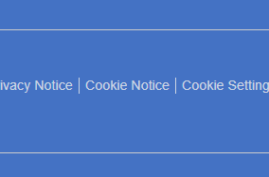
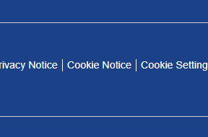
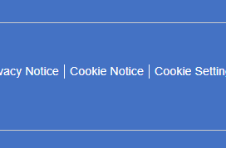
Color Contrast Ratio
Web pages should also have a minimum contrast by default: a contrast ratio of at least 4.5:1 for normal-size text.
Who needs it?
Everyone! An obvious example is someone who has color deficiencies or has low vision … but remember that there are other scenarios from trying to read a screen in bright light to users who require low luminosity due to reading disabilities like dyslexia.
The good news
Your portal has been designed with accessibility in mind. While the overall color palette adheres to your brand, care has been taken to ensure that correct contrast ratios are already in place.

Slide 10
Dos and Don’ts
Do…
Provide captions or transcripts of audio components like videos for those with hearing impairment
Provide audio or screen-readable text alternatives to video for low or no-vision users
Take the time to develop clear, concise, jargon-free content and organize it using hierarchical sections
Don’t…
Center or full justify text. It makes it hard to read.
Just use bold for headings. Use markup, e.g., h2, h3, etc.
Use flashing or blinking elements
Rely on color alone to indicate critical information or call to action
Forget that good accessibility benefits everyone!

Slide 11
Resources
[work in progress]
Before and after page from WCAG
https://www.w3.org/WAI/demos/bad/after/tickets.html
Luminosity Colour Contrast Ratio Analyser
https://juicystudio.com/services/luminositycontrastratio.php#specify

